Slide 1
EF-EP-005-MCB
EPIC:
Selected Financial Product

Slide 2
EF-EP-005: Selected Financial Product
Story ID: ES-S 001:
As a user I want to select the SF Product and adjust the parameter to my needs so that I can get the SF Product that fits my personal needs
Story ID: ES-S 002:
As a user I want to add associated products to the finance offer so that I can add vehicle accessories and etc. to the to be financed amount
Story ID: ES-S 003:
As a user I want to select Herald Leasing products so that I can chose leasing products
Story ID: ES-S 004:
As a existing customer and eApp user I want to be able to select the loyalty SF offer so that I can enjoy the loyalty program interest rate subsidy.
Story ID: ES-S 005:
As a user, I want to be notified in how many days the offer is expired.
Story ID: ES-S 006:
As a user, I want to be select dealer specific SF products so that i can enjoy dealer specific SF campaigns.

Slide 3
Story ID: EF-EP-005-ES-S 001: Select SF Product
OWNER: PO (BA)
Business
As a user I want to select the SF Product and adjust the parameter to my needs so that I can get the SF Product that fits my personal needs
Assumptions:
Customer Successfully registered or used existing GCDM/BMW Account to login to BMW Easy Finance APP.
Customer Successfully Redirected himself to Product Selection page upon using User friendly App’s Navigation
Customer is physically at the dealership in the reach of F&I
Customer has successfully selected vehicle, dealer and transaction price confirmed (EF-EP-004-ES-S 001, EF-EP-004-ES-S 004, EF-EP-004-ES-S 005)
Pre-Conditions:
Customer should be allowed to select various filter parameters to select the SF Product.
Customer has selected vehicle, dealer and transaction price
Acceptance Criteria:
SF Web Calculator Java Script Front end is loaded
User selects SF Product by swiping (for devices <iPad Pro) or clicking (PC)
User can click on information icon to display information of the product
User selects down / balloon payment & percentage by selecting from the dropdown
User can selects the term by swiping (for devices <iPad Pro) or clicking (PC)
SF disclaimer is displayed
Once the SF Product is selected and adjusted user can click next and enters “the confirmation page”
The user can click back button and enters to transaction price page
If the user has not changed the default calculation and clicks submit a pop up is guiding the customer how to enter and disclaimer that the quotation will be review by the F&I. User can click ok and the default calculation is submitted, or user clicks cancel and can adjust the SF Product.
Legal
IT
Security

Slide 4
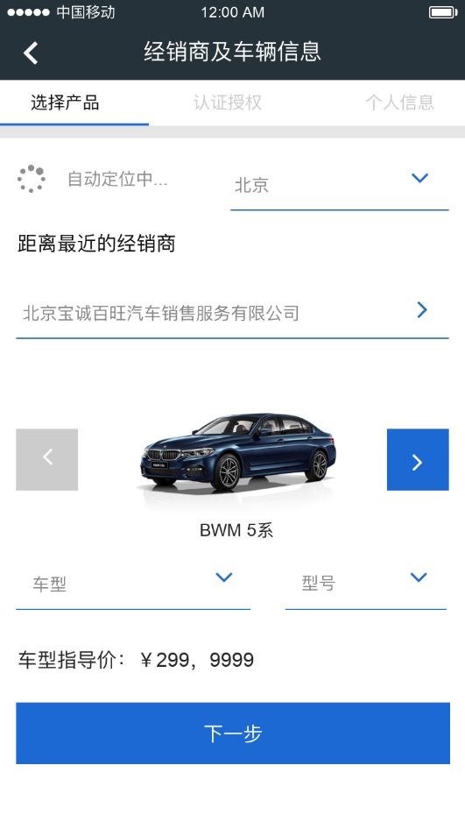
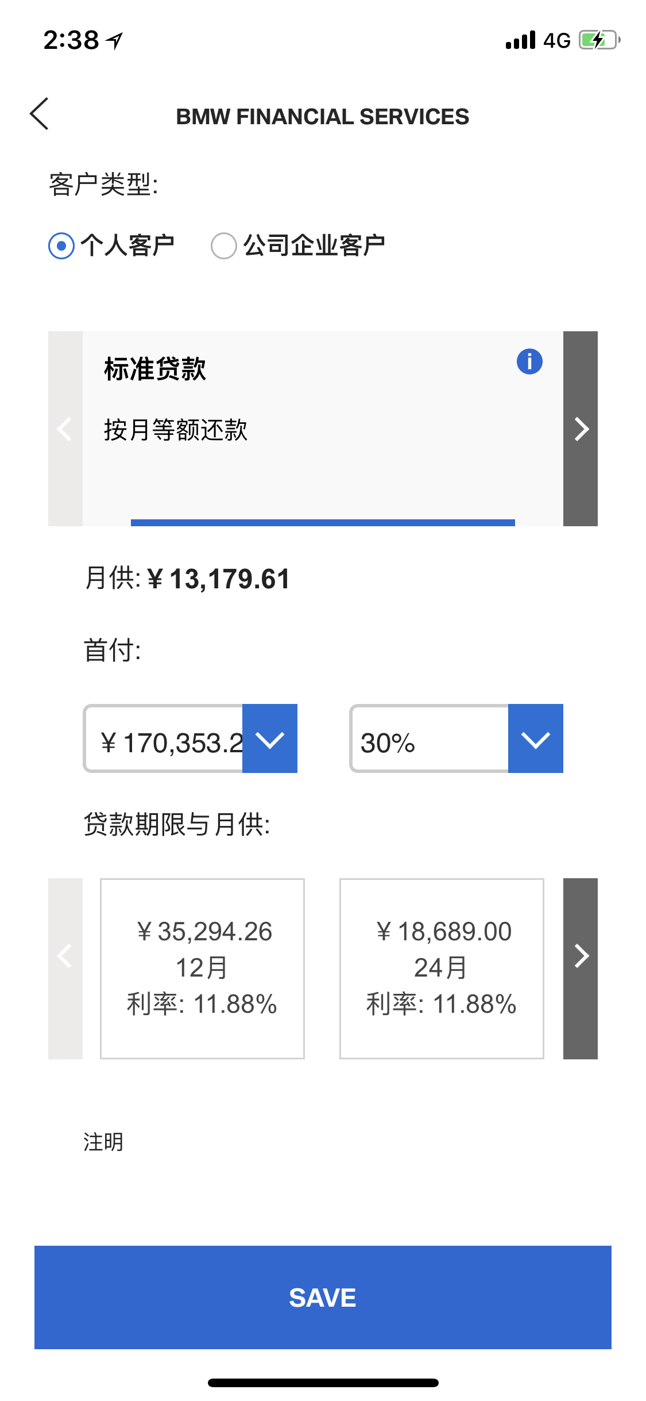
Story ID: EF-EP-005-ES-S 001 Select SF Product
Mockups:
If
If AG_VG code from parent page is correct, SF Web Calculator will provide:
SF Standard and Campaign Product
Financial Options/Parameters, down payment, balloon percentage, etc.
Information to generate quotation for customer;
Quotation content and design can refer to DMO.

Slide 5
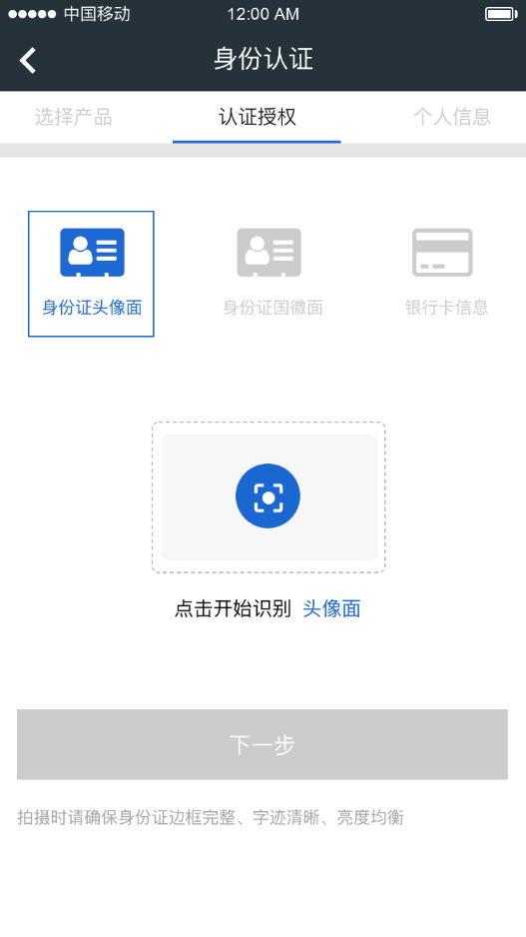
Story ID: EF-EP-005-ES-S 001 Select SF Product
Wireframes
$ 250, 000

Slide 6
Story ID: EF-EP-005-ES-S 001 Select SF Product
Process Flow:
Easy Finance APP
Registration
Process

Slide 7
Story ID: EF-EP-005-ES-S 001 Select SF Product
Sequence Flow

Slide 8
Story ID: EF-EP-005-ES-S 002: ASP Products
OWNER: PO (BA)
Business
Legal
As a user I want to add associated products to the finance offer so that I can add vehicle accessories and etc.
to the to be financed amount
Assumptions:
Customer Successfully registered or used existing GCDM/BMW Account to login to BMW Easy Finance APP.
Customer Successfully Redirected himself to Product Selection page upon using User friendly App’s Navigation
Customer is physically at the dealership in the reach of F&I
Customer has successfully selected vehicle, dealer and transaction price confirmed (EF-EP-004-ES-S 001, EF-EP-004-ES-S 004, EF-EP-004-ES-S 005)
Pre-Conditions:
Customer should be allowed to select various filter parameters to select the ASP SF Product.
Customer has selected vehicle, dealer and transaction price confirmed
Acceptance Criteria:
User enters the ASP price into the empty box.
Disclaimer and guide is shown (information icon).
In the box only a reasonable amount can be entered. Once alphabetic, icons or an unreasonable amount is input (to be defined: e.g. 0, >10% of MSRP) a pop up message should guide the user entering the right amount (including disclaimer)
User can only click submit if all criteria are met (e.g. Quotation & ASP price is entered correctly and Dealership / Vehicle is selected)
IT
Security

Slide 9
Story ID: EF-EP-005-ES-S 002 ASP Products
Mockups:
Transaction Price
$ 250, 000
ASP Price
$ 10, 000

Slide 10
Story ID: EF-EP-005-ES-S 002 ASP Products
Wireframes
Transaction Price
ASP Price
$ 10, 000
$ 250, 000
ASP Price
$ 250, 000
$ 10, 000

Slide 11
Story ID: EF-EP-005-ES-S 002 ASP Products
Process Flow:
Easy Finance APP
Registration
Process

Slide 12
Story ID: EF-EP-005-ES-S 002 ASP Products
Sequence Flow

Slide 13
Story ID: EF-EP-005-ES-S 003: HIL Products
OWNER: PO (BA)
Business
Legal
As a user I want to select Herald Leasing products so that I can chose leasing products
Assumptions:
Customer Successfully registered or used existing GCDM/BMW Account to login to BMW Easy Finance APP.
Customer Successfully Redirected himself to Product Selection page upon using User friendly App’s Navigation
Customer is physically at the dealership in the reach of F&I
Customer has successfully selected vehicle, dealer and transaction price confirmed (EF-EP-004-ES-S 001, EF-EP-004-ES-S 004, EF-EP-004-ES-S 005)
Pre-Conditions:
Customer should be allowed to select various filter parameters to select the SF Product.
Customer has selected vehicle, dealer and transaction price confirmed
Acceptance Criteria:
SF Web Calculator Java Script Front end is loaded
User selects HIL Product by swiping (for devices <iPad Pro) or clicking (PC)
User can click on information icon to display information of the product
User selects down payment & percentage by selecting from the dropdown
The CRV is displayed
User can selects the term by by swiping (for devices <iPad Pro) or clicking (PC)
HIL disclaimer is displayed
Once the SF Product is selected and adjusted user can click next and enters “quotation confirmation page ”
The user can click back button and enters landing page
IT
Security
HIL

Slide 14
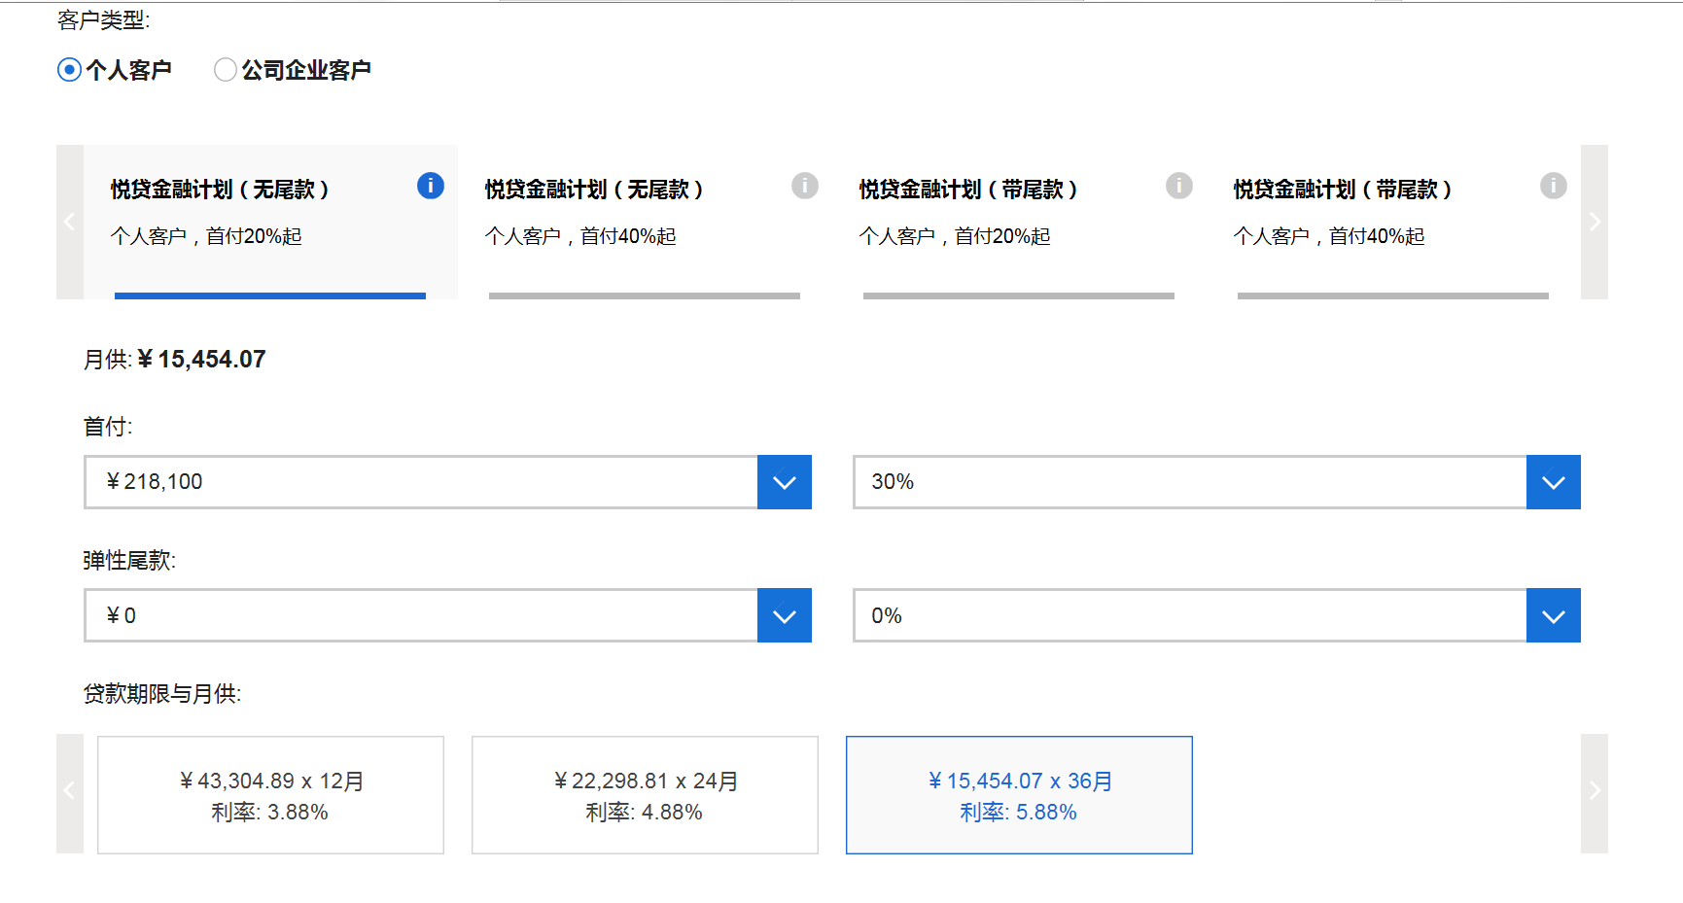
Story ID: EF-EP-005-ES-S 003 HIL Products
Mockups:
悦选明天计划
月付
79,000
最低回购价/尾款:
79,000
期限：
24
36

Slide 15
Story ID: EF-EP-005-ES-S 003 HIL Products
Wireframes
To be adjusted to HIL Product e.g. OC
$ 250, 000

Slide 16
Story ID: EF-EP-005-ES-S 003 HIL Products
Process Flow:
Easy Finance APP
Registration
Process

Slide 17
Story ID: EF-EP-005-ES-S 003 HIL Products
Sequence Flow

Slide 18
Story ID: EF-EP-005-ES-S 004: Loyalty SF Offer
OWNER: PO (BA)
Business
Legal
As a existing customer and eApp user I want to be able to select the loyalty SF offer
so that I can enjoy the loyalty program interest rate subsidy.
Assumptions:
Customer Successfully registered or used existing GCDM/BMW Account to login to BMW Easy Finance APP.
Customer Successfully Redirected himself to Product Selection page upon using User friendly App’s Navigation
Customer is physically at the dealership in the reach of F&I
Customer has successfully selected vehicle, dealer and transaction price confirmed (EF-EP-004-ES-S 001, EF-EP-004-ES-S 004, EF-EP-004-ES-S 005)
Pre-Conditions:
Customer should be allowed to select various filter parameters to select the SF Product.
Customer has selected vehicle, dealer and transaction price confirmed
Customer is identified as SF loyalty program user and is entitled to the SF loyalty offer
Acceptance Criteria:
Acceptance Criteria A
Acceptance Criteria B
Acceptance Criteria C
Acceptance Criteria D
IT
Security

Slide 19
Story ID: EF-EP-005-S004-MCB Loyalty SF Offer
Mockups:
To be adjusted to Loyalty Product

Slide 20
Story ID: EF-EP-005-ES-S 004 Loyalty SF Offer
Wireframes
To be adjusted to Loyalty Product
$ 250, 000

Slide 21
Story ID: EF-EP-005-ES-S 004 Loyalty SF Offer
Process Flow:
Easy Finance APP
Registration
Process

Slide 22
Story ID: EF-EP-005-ES-S 004 Loyalty SF Offer
Sequence Flow

Slide 23
Story ID: EP005-S005-Alex Wang:
Business
As a user, I want to be notified in how many days the offer is expired.
Assumptions:
Customer Successfully registered or used existing GCDM/BMW Account to login to BMW Easy Finance APP.
Customer Successfully Redirected himself to Product Selection page upon using User friendly App’s Navigation
Customer is physically at the dealership in the reach of F&I
Pre-Conditions:
Stand alone financial calculator in eAPP.
The expiration rules of financial product has been configured in eAPP or one calculator.
All quotation information which DFE is needed (incl. transaction price) is selected by applicants in eAPP.
Acceptance Criteria:
The App will auto-check expired date of selected financial product before applicant click ‘submit quotation’ button.
If the submission date is within X days from expired date of selected financial product, a pop-up will remind applicant that “Please submit your loan application in X days.”

Slide 24
Story ID: EP006-S001-Alex Wang:
Mockups:
For soon to expire product
back
Quotation overview
Model
Please submit your loan application in X days
Transaction Price
Financial product
OK
。。。
Monthly installment
Submit Quotation to confirm

Slide 25
Story ID: EP006-S001-Alex Wang:
Wireframes
Your quotation is submitted successfully.
Please wait a moment for your F&I to confirm…
Please submit your loan application in X days
OK
$ 250, 000

Slide 26
Story ID: EF-EP-005-ES-S 006: Select dealers specific product
OWNER: PO (BA)
Business
As a user I want to select the SF Product and adjust the parameter to my needs so that I can get the SF Product that fits my personal needs
Assumptions:
Customer Successfully registered or used existing GCDM/BMW Account to login to BMW Easy Finance APP.
Customer Successfully Redirected himself to Product Selection page upon using User friendly App’s Navigation
Customer is physically at the dealership in the reach of F&I
Customer has successfully selected vehicle, dealer and transaction price confirmed (EF-EP-004-ES-S 001, EF-EP-004-ES-S 004, EF-EP-004-ES-S 005)
Pre-Conditions:
Customer should be allowed to select various filter parameters to select the SF Product.
Customer has selected vehicle, dealer and transaction price confirmed
Acceptance Criteria:
SF Web Calculator Java Script Front end is loaded
User selects dealers specific SF Product by swiping (for devices <iPad Pro) or clicking (PC)
User can click on information icon to display information of the product
User selects down / balloon payment & percentage by selecting from the dropdown
User can selects the term by swiping (for devices <iPad Pro) or clicking (PC)
SF disclaimer is displayed
Once the SF Product is selected and adjusted user can click next and enters “the confirmation page”
The user can click back button and enters landing page
Legal
IT
Security

Slide 27
Story ID: EF-EP-005-ES-S 006 Select dealers specific product
Mockups:
Select dealers specific product

Slide 28
Story ID: EF-EP-005-ES-S 006 Select dealers specific product
Wireframes
$ 250, 000

